Slide 1
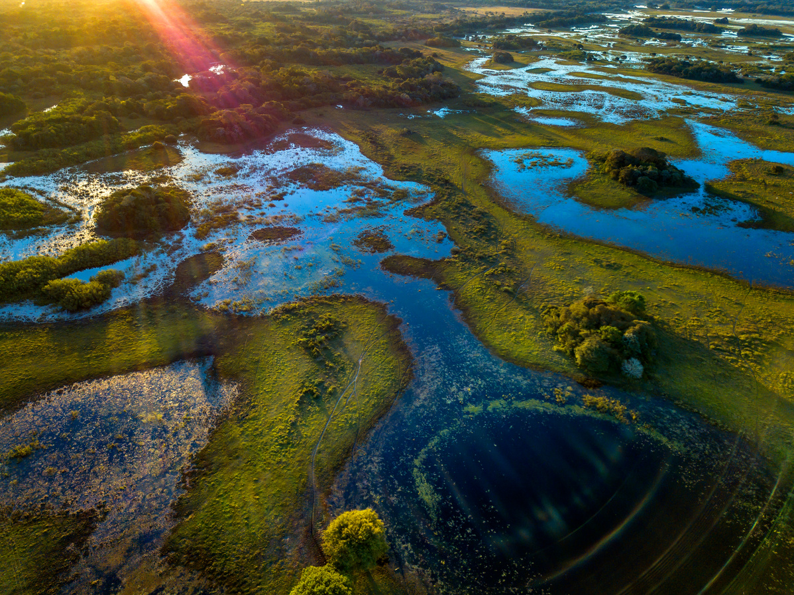



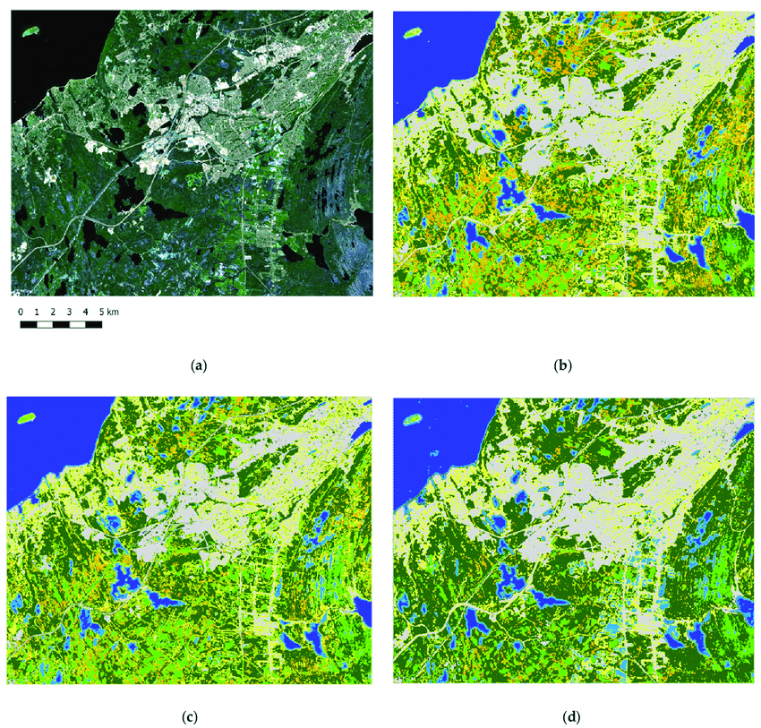
WETLAND LOCALIZATION
Using Satellite Imagery and Deep Learning
Abhishek THOMAS, Dilara TOYGAR, Erwin BYLL, Henry TURNBULL, Siwen LU

Slide 2
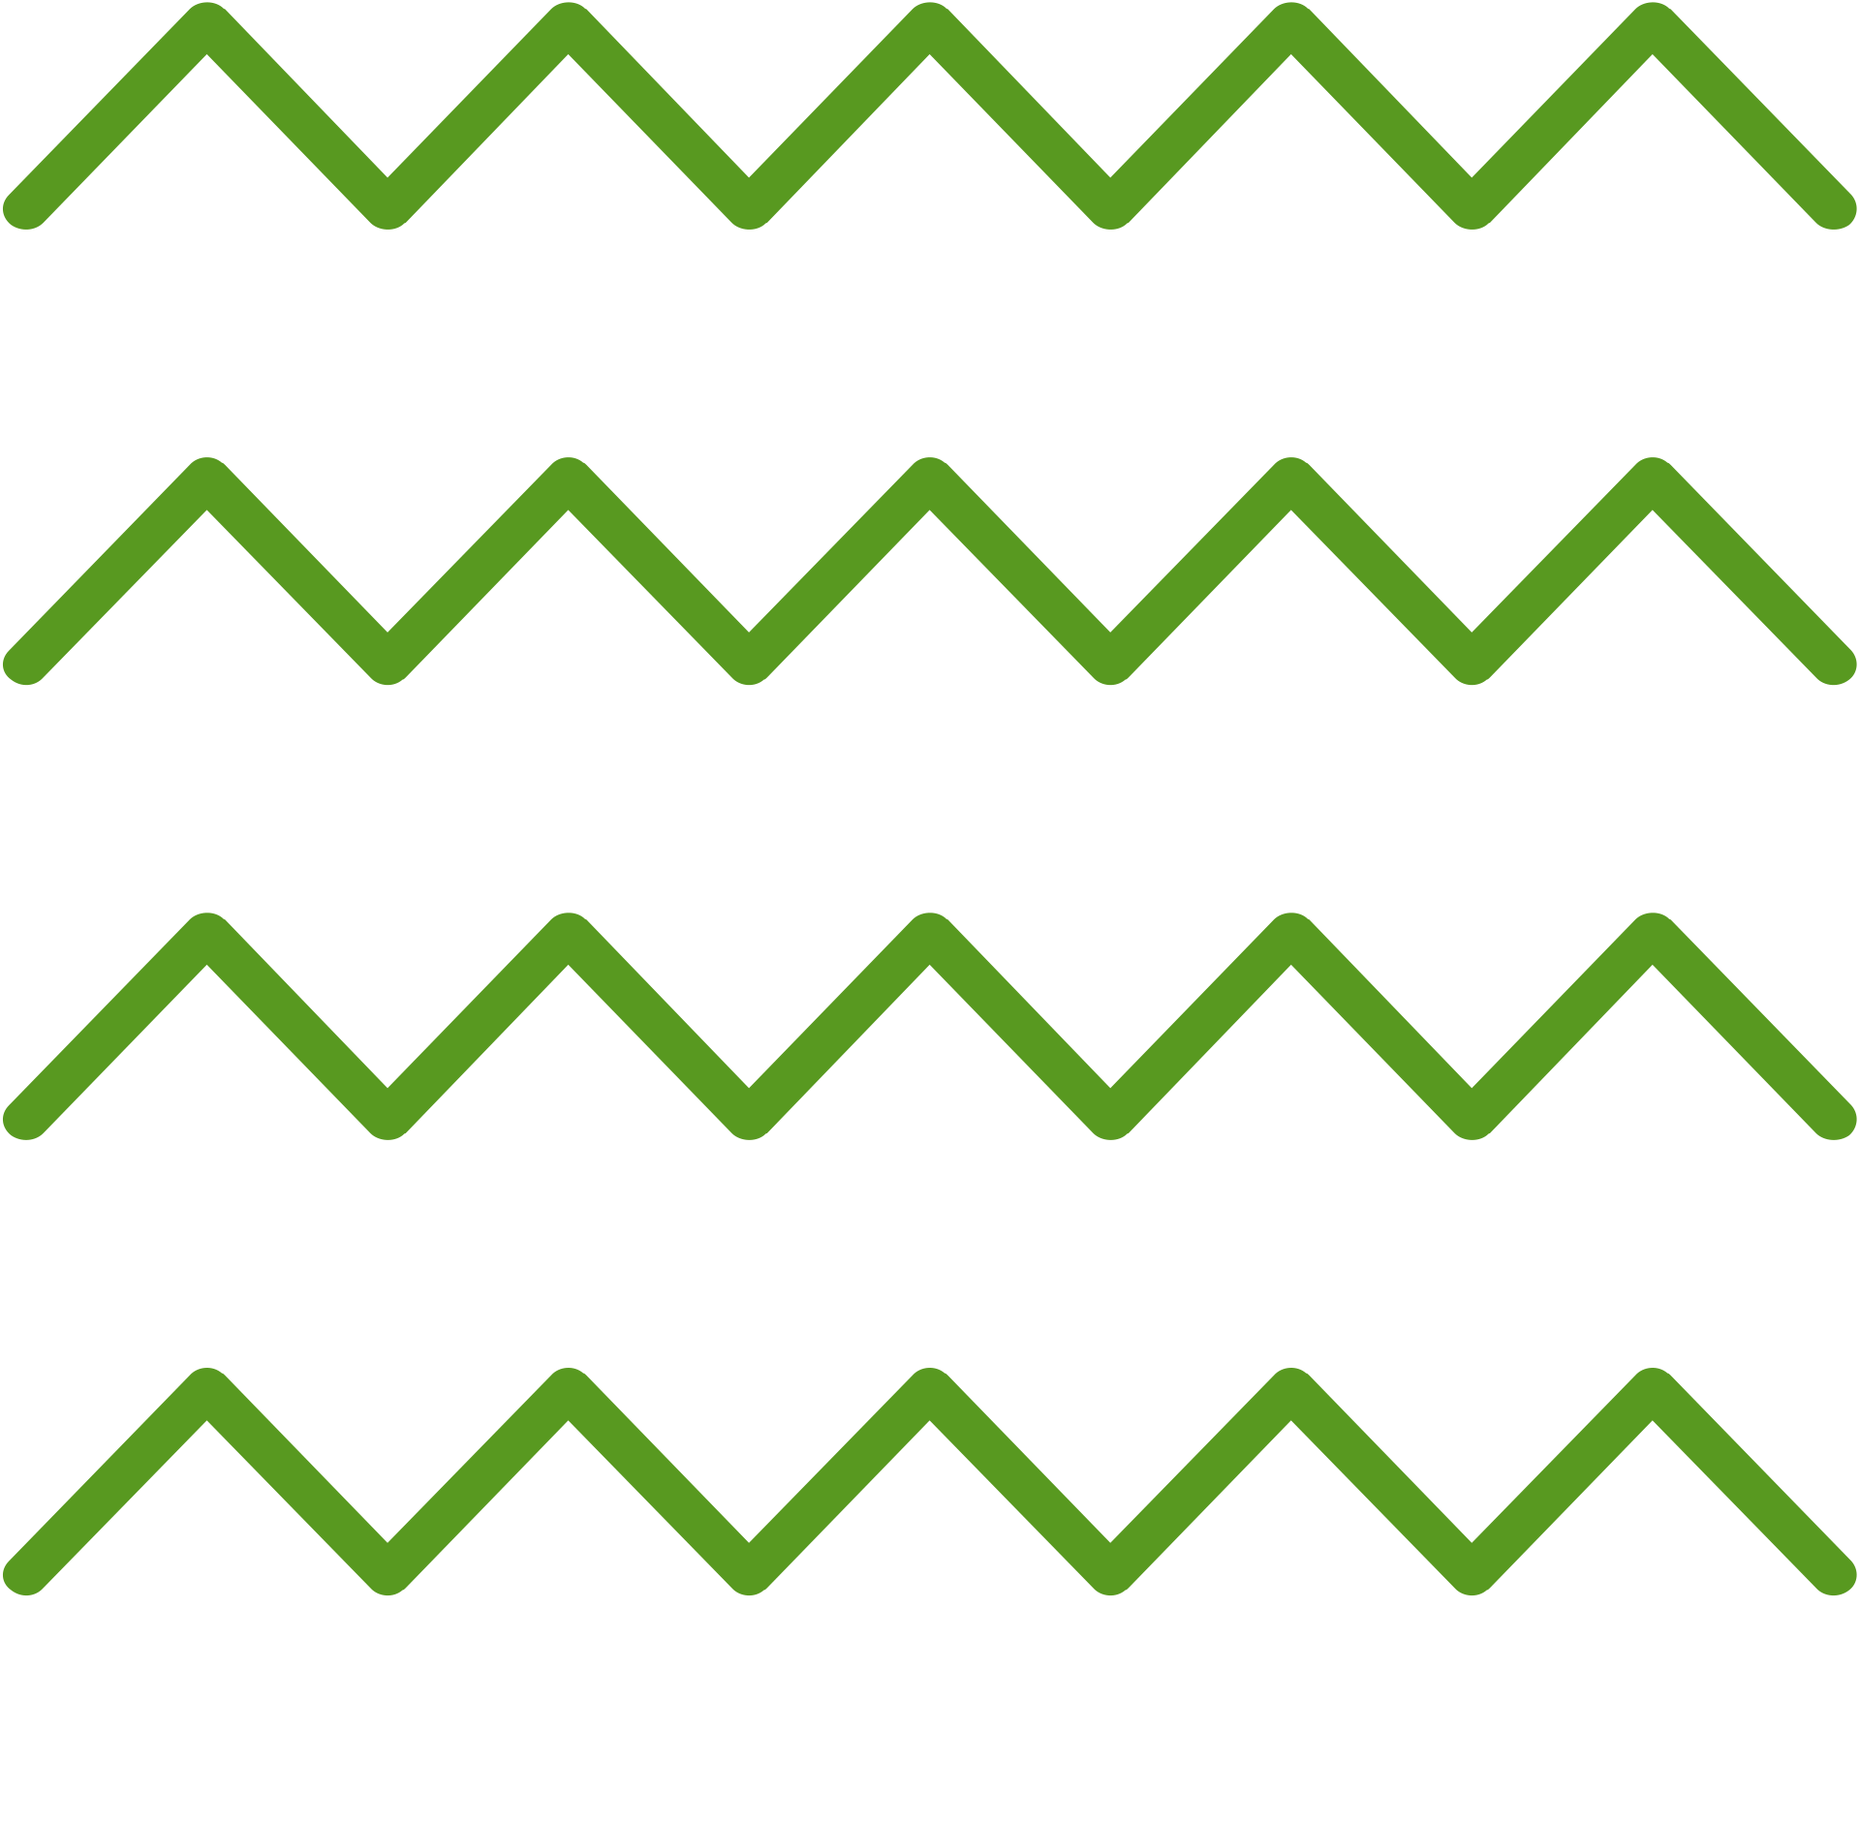
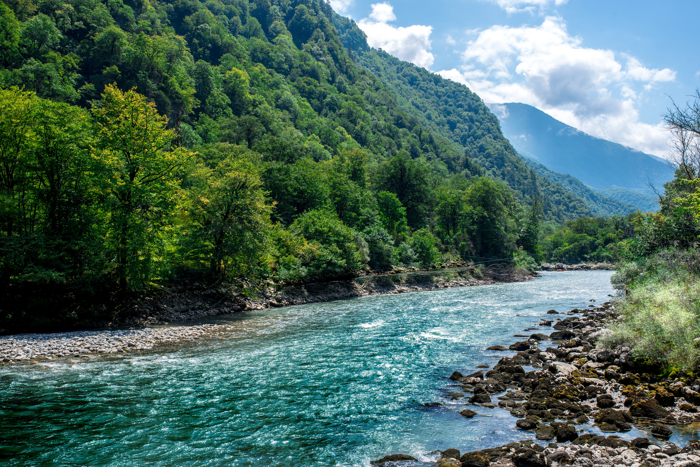


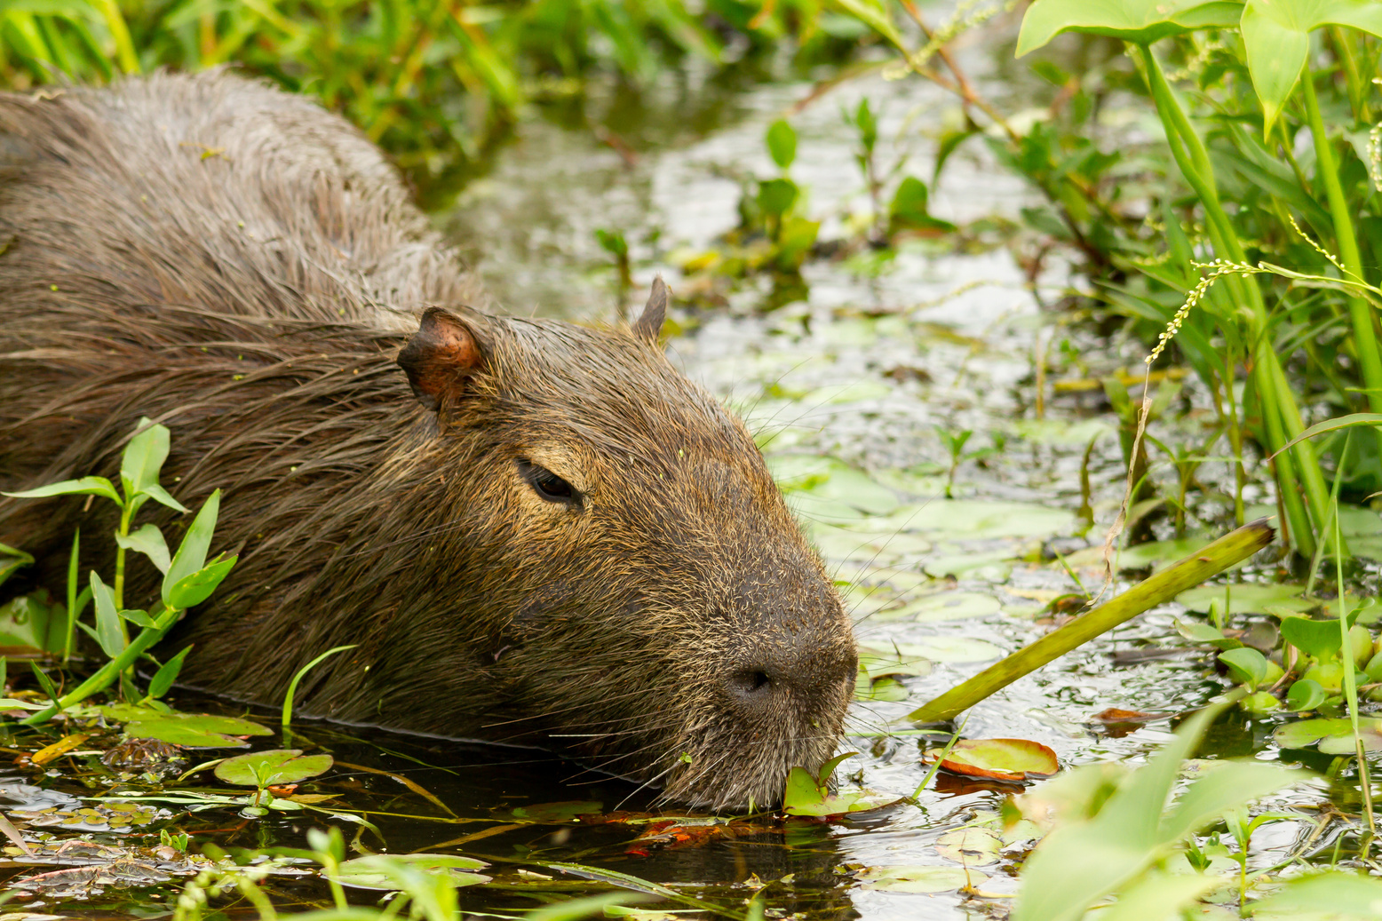

WHY WETLANDS MATTER？
Water Filtration
Recharge local groundwater and prevent downstream flooding. Trap nutrient and sediment pollution, sending cleaner water downstream.
Carbon storage
Wetlands only make up about 5–8% of the Earth’s land, they hold between 20–30% of the planet’s total soil carbon.
Biodiversity
Wetlands cover just 7 percent of the planet but are home to 40% of the world’s biodiversity.

Slide 3


CHALLENGE & PROJECT OBJECTIVES
Project Goal
Develop AI solution to predict wetland locations using satellite data, enhancing wetland detection capabilities.
Key Objectives
Develop and enhance U-Net models for wetland segmentation.
Explore pre-trained models from Hugging Face optimized for satellite imagery.
Create effective data processing strategies to maximize limited dataset value.
Develop methods for addressing cloud interference in satellite images.
Demonstrate a working prototype for wetland detection.
The main challenge is to accurately map wetlands despite the limitations of traditional fieldwork methods, which can be time-consuming and resource-intensive. This is crucial for monitoring and conservation, as knowing wetland locations helps optimize field expertise efforts and supports ecological studies.
Expected Impact
Create scalable, automated tools for environmental monitoring that reduce dependency on traditional field surveys and optimize conservation strategies.

Slide 4
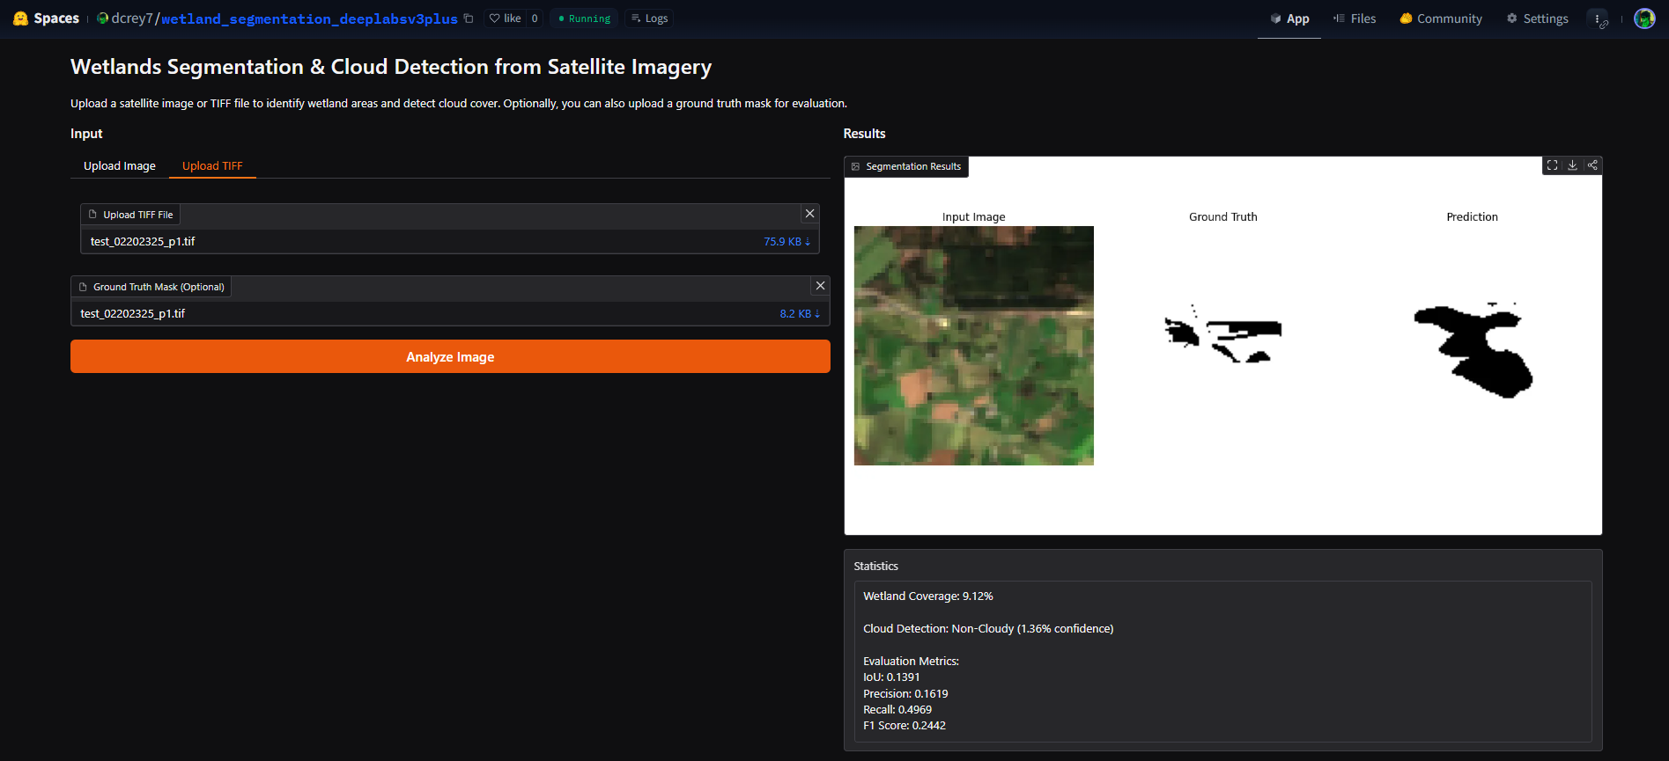
WEB APP DEMO
This application uses 2 models:
1. Wetland Segmentation Model:
Architecture: DeepLabv3+ with ResNet-34
Input: RGB satellite imagery
Output: Binary segmentation mask (Wetland vs Background)
2. Cloud Detection Model:
Architecture: LightGBM Classifier
Input: CV features extracted from up to 10 image bands
Output: Binary classification (Cloudy vs Non-Cloudy) with probability

Slide 5
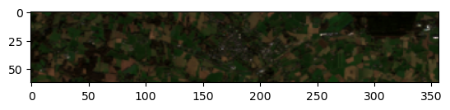
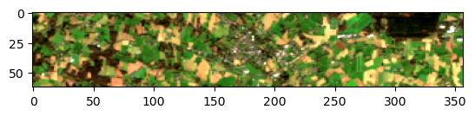
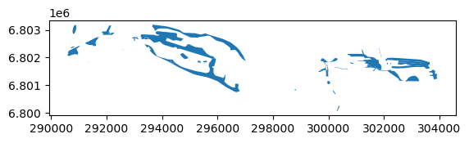
DATA OVERVIEW
Data Source: 36 Sentinel-2 images (Jan 2021 - Dec 2023) of the same area in France
Image Properties: 62×357 pixels, 54.85m resolution, GeoTIFF format with metadata
Bands: 10 spectral bands available, with detailed metadata for RGB bands
Ground Truth: Wetland shapefiles provided by client (Egis)
Class Imbalance: Wetlands 8.93% (5.95M m²) vs. Non-wetlands 91.07% (60.64M m²)
Temporal Aspect: Monthly images with minimal cloud coverage, chronologically ordered

Slide 6
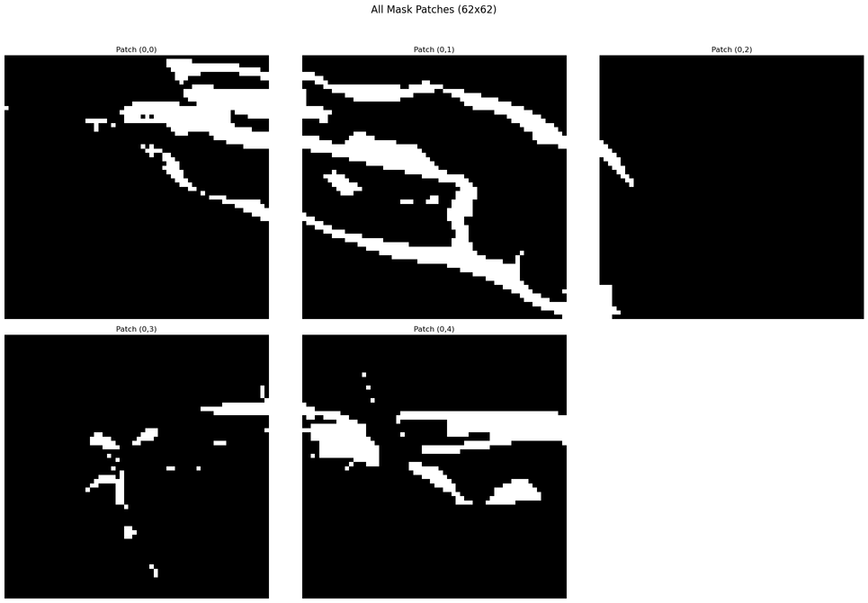
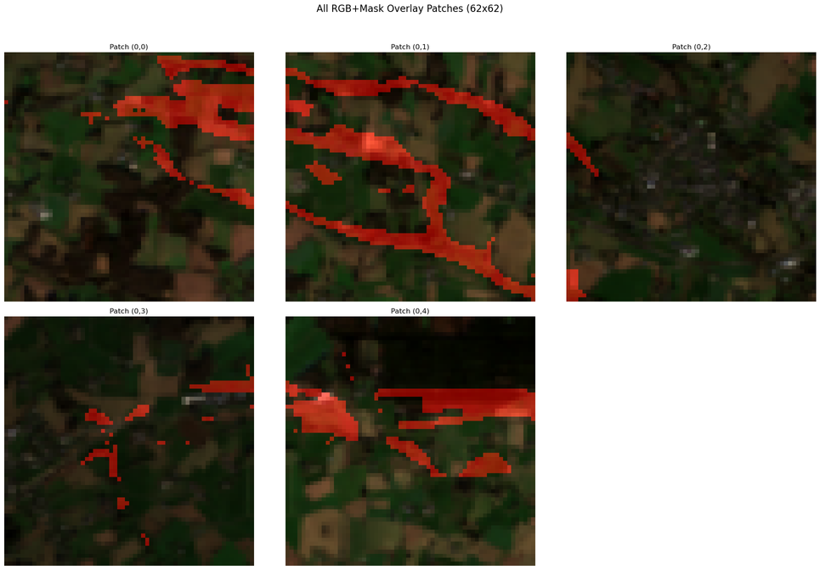
DATA PROCESSING PIPELINE
Patching Strategy
Split each 62×357 pixel image into five 62×62 squares
Cropped to 310 pixels width to enable even division
Created 36×5=180 total image patches and corresponding mask patches
Cloud Detection
Custom tool for initial manual classification (19.4% cloudy)
Used band Coefficient of Variation as discriminative features
Trained ML models for automated detection
SHAP analysis for feature importance interpretation
Train/Validation/Test Split
Structured split: 3 patches for training, 1 for validation, 1 for testing
Consistent patch allocation across all 36 time periods
Same regions in validation/test sets to prevent data leakage

Slide 7
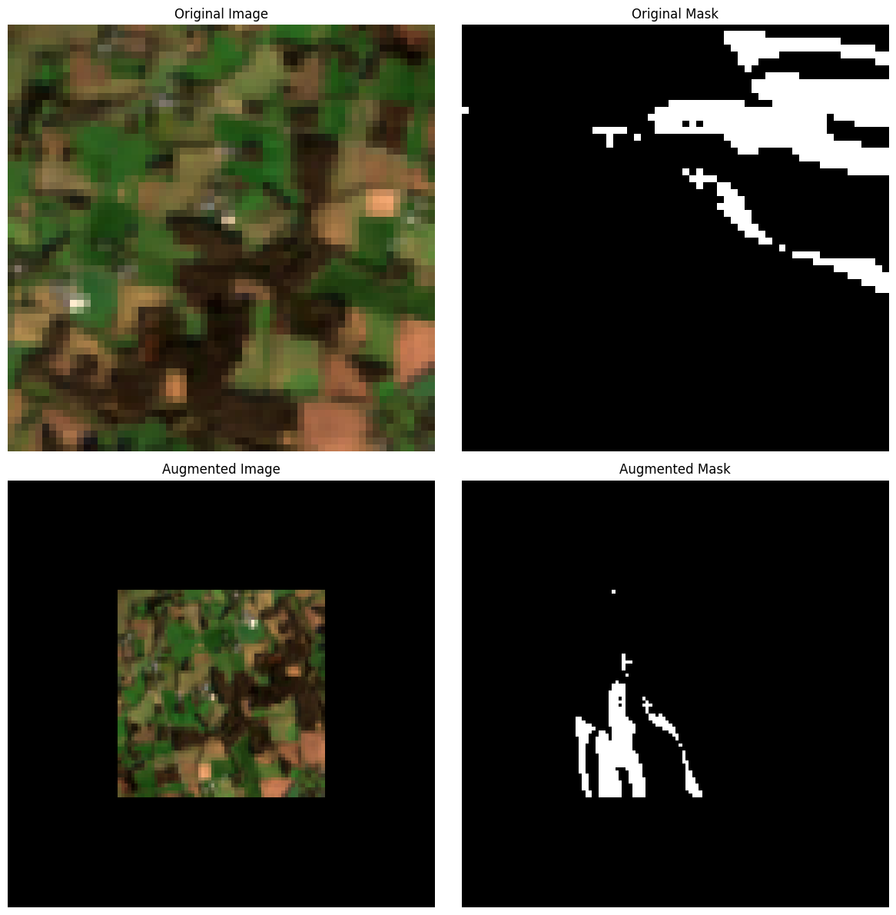
FEATURE ENGINEERING
Band Selection
RGB bands only for pre-trained models (U-Net, DeepLabV3+)
Full 10 bands + calculated NDVI & NDWI for custom Small U-Net model
Full 10 bands for cloud detection, calculated Coefficient of Variation (CV) for each tile and each band
Image Preparation
Padding preferred over resizing to preserve mask quality
Padding to 128×128 pixels for pre-trained model compatibility
Data Augmentation
Horizontal flips, vertical flips, 90° rotations
Random cropping to 128×128
Consistent transformations for both images and masks via albumentations

Slide 8
MODEL ARCHITECTURE & EVALUATION
Small U-Net (from scratch)
Cloud Detection Framework:
12 input bands (10 original + NDVI & NDWI)
Two consecutive 3×3 convolutional layers with Batch Normalization and ReLU
Encoder-decoder structure with skip connections
Binary segmentation output with sigmoid activation
Trained with early stopping (patience=15, max epochs=100)
CV calculated across all 10 bands as discriminative features
ML models comparison: LightGBM, XGBoost & CatBoost, Random Forest
Loss Functions
DiceLoss (all models) due to its effectiveness with imbalanced classes. Focuses on the overlap between predicted and ground truth segmentation
Pre-trained Models
One fine-tuned model and one transfer-learning model each
U-Net with ResNet34 encoder (ImageNet weights)
DeepLabV3+ with ResNet34 encoder (ImageNet weights)
3 input channels (RGB), binary output
Key Metrics
Mean Intersection over Union (IoU): Background IoU, Wetland IoU, and IoU
Analysis
Precision, Recall, F1 Score, Confusion matrix

Slide 9
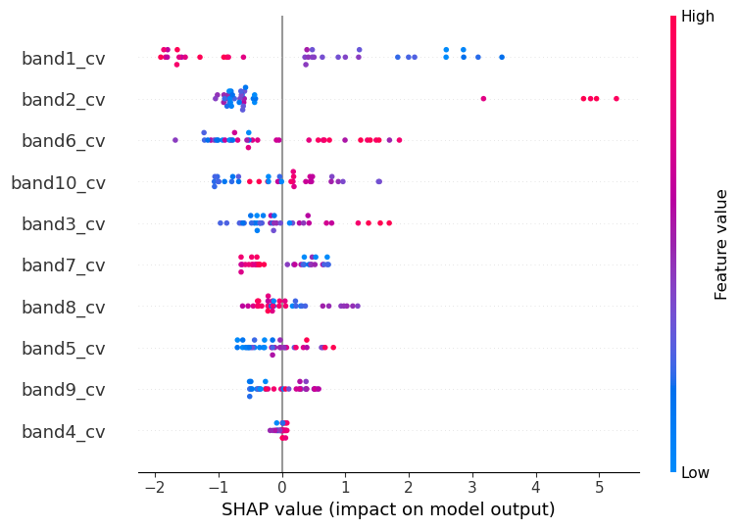
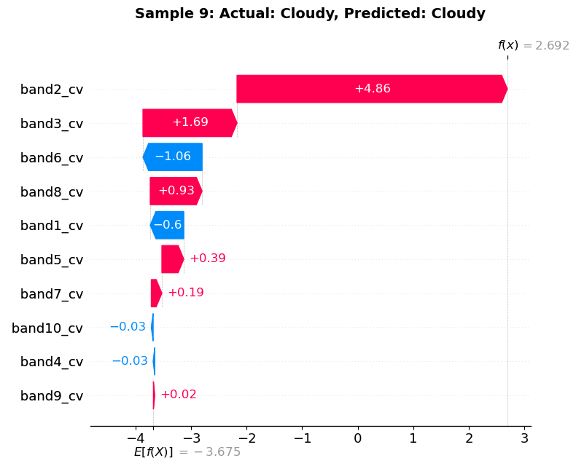
RESULTS - CLOUDY IMAGE MODEL
Model | TP | TN | FP | FN | Precision | Recall | F1_Score
LightGBM | 5 | 28 | 2 | 1 | 0.71 | 0.83 | 0.77
XGBoost | 4 | 29 | 1 | 2 | 0.80 | 0.67 | 0.73
CatBoost | 4 | 29 | 1 | 2 | 0.80 | 0.67 | 0.73
Random Forest | 4 | 28 | 2 | 2 | 0.67 | 0.67 | 0.67
LightGBM achieved the highest F1-score (0.77) for cloud detection.
Band 1 showed highest predictive importance in overall SHAP analysis.
Example patch analysis: 96.15% confidence for cloud presence.

Slide 10
RESULTS - IMAGE SEGMENTATION
DeepLabV3+
Unet
Small U-Net
Best test performance with the Finetuned (FT).
Better generalization to unseen data, despite its more modest training performance.
Strongest training performance but signs of overfitting.
Very low wetland IoU shows difficulty generalizing to unseen wetland patterns.
Limited learning capacity.
Very poor wetland detection, limited capability for this task with available data volume.
Model | Epochs | Train_bg_iou | Train_wetland_iou | Train_mean_iou | Val_bg_iou | Val_wetland_iou | Val_mean_iou | Test_bg_iou | Test_wetland_iou | Test_mean_iou
DeepLabV3plus_FT | 68 | 97.8 | 42.6 | 70.2 | 97.49 | 8.29 | 52.89 | 95.4 | 10.02 | 52.71
Unet_FT | 88 | 99.31 | 76.4 | 87.85 | 97.9 | 6.71 | 52.31 | 96.25 | 5.34 | 50.8
DeepLabV3plus_TL | 33 | 89.03 | 16.59 | 52.81 | 87.15 | 3.23 | 45.19 | 86.7 | 12.04 | 49.37
Unet_TL | 28 | 87.79 | 16.3 | 52.05 | 85.13 | 3.03 | 44.08 | 84.73 | 11.53 | 48.13
SmallUNet | 30 | 86.5 | 19.02 | 52.76 | 93.97 | 1.71 | 47.84 | 81.53 | 12.17 | 46.85
FT - Finetuned
TL- Transfer learning

Slide 11
01
Data Limitations
Insufficient training samples for deep learning.
Low resolution imagery (54.85m per pixel).
Small patch sizes (62×62) incompatible with typical DL architectures.
Need to remove cloudy patches from images, further reducing usable data.
KEY LIMITATIONS
02
Technical Constraints
Pre-trained models restricted to RGB channels despite having 10 bands available.
Cloud presence in nearly 20% of our dataset affecting feature extraction.
Severe class imbalance making wetland detection particularly difficult.
Absence of wetland-specific pre-trained models in the open source community.

Slide 12



FUTURE DIRECTIONS
Higher Quality Data Acquisition
Collect 1000+ higher resolution Sentinel-2 patches with complete metadata
Ensure image dimensions divisible by 8/32/64/128/256/512 for architecture compatibility
Address class imbalance through targeted augmentation techniques
Advanced Technical Approaches
Enhance cloud detection with improved deep learning methods
Calculate additional spectral indices and band ratios for feature enrichment
Explore traditional ML models (Random Forest, SVM) as comparative baselines
Multi-band Architecture Development
Design architectures accepting all 12 bands (10 original + NDVI & NDWI)
Implement true transfer learning with final layer fine-tuning
Develop specialized wetland segmentation models for open source community

Slide 13
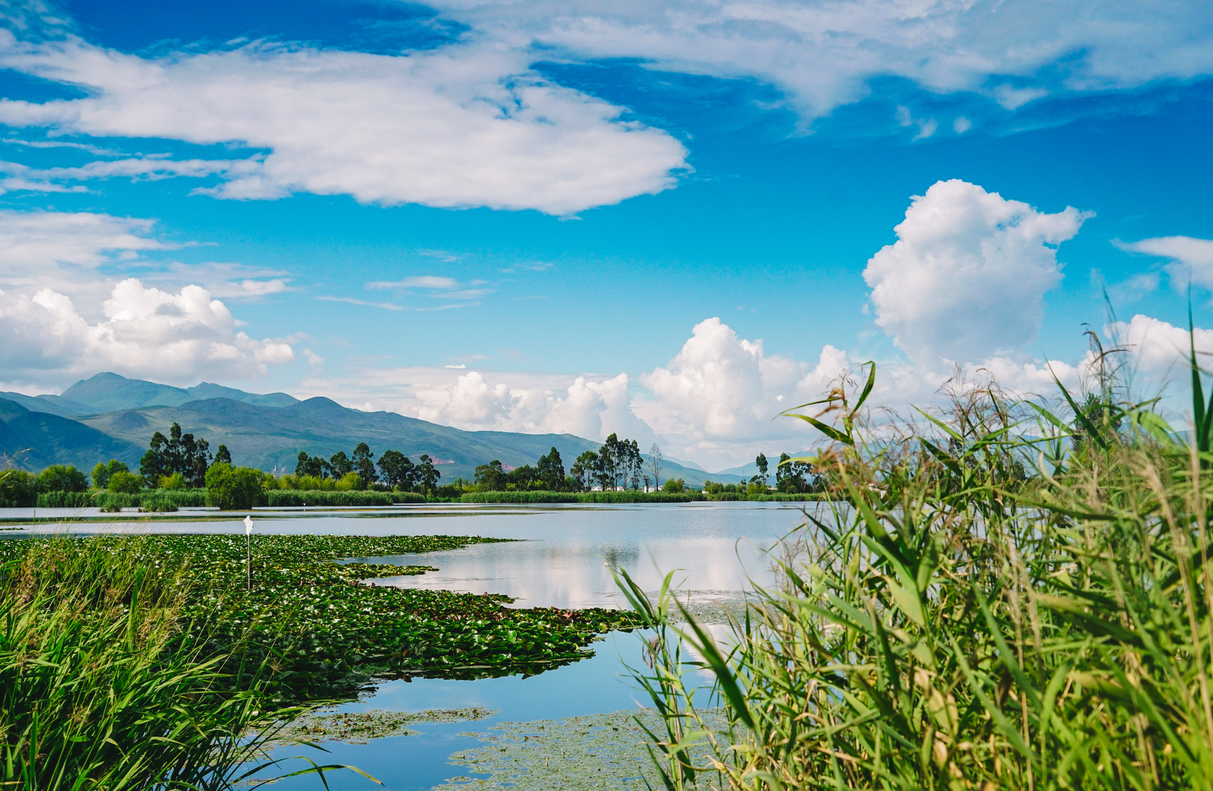
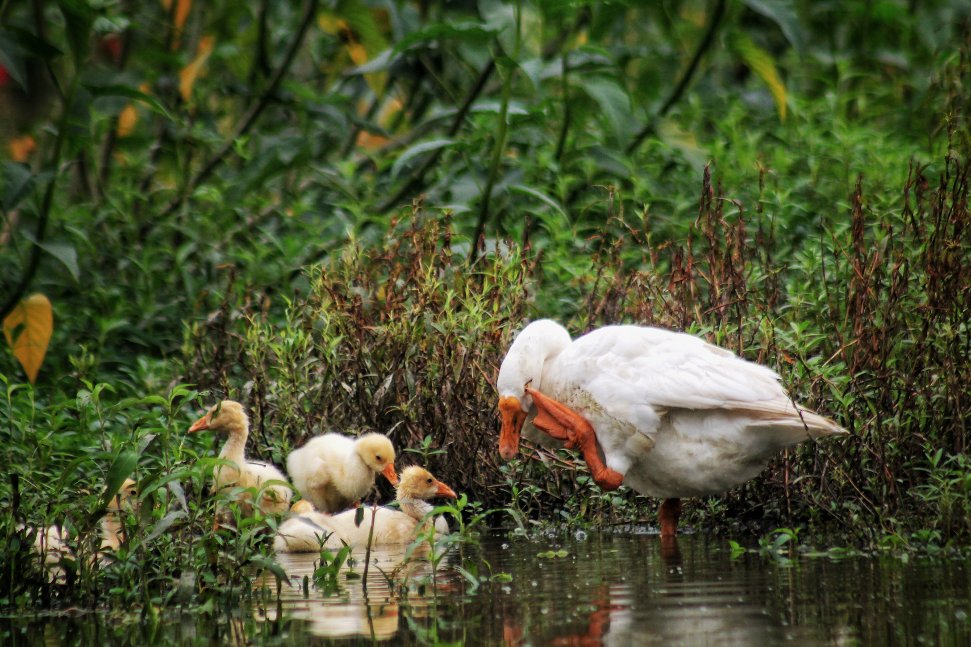
THANK YOU

